Slide 1
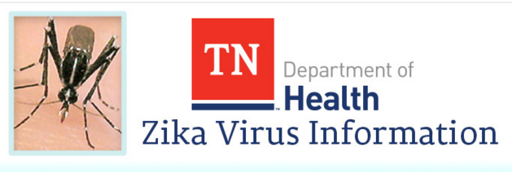
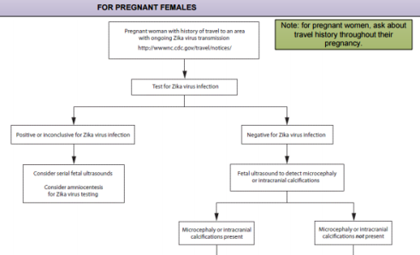
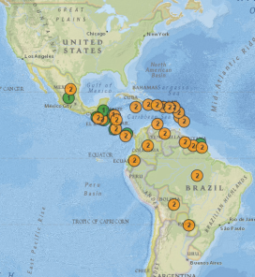
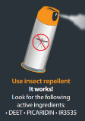
Pregnancy: microcephaly risk for infants; TN baseline incidence= 45-50/yr
Currently no reported local U.S. Zika spread, 43 states w/travel associated cases, plus DC.
Aedes Mosquito Range
Association with Guillain-Barré syndrome; TN baseline incidence =15-19 cases annually each of the last 3 years
Mosquitoes typically expected in April in TN
TDH communicating through Zika web site, health alerts, clinician guidance, lab instructions, and media
Local capacity for mosquito abatement:
3 counties and 11 cities
Direct email to 28,000+ to clinicians with update.
“Tip and Toss”, “Drain and Cover” to reduce breeding sites and mosquito populations
10% Drop in tourism➔~$2.9 billion cost to State
All travelers to countries with local transmission should take personal steps to “Fight the Bite” in country and upon return to TN
Sexual transmission occurs-7 U.S. cases
Confirmed Case Count: 3
Lab Tests Approved: 145 (as of 5/16/16 )
~1/5 have mild symptoms, lasting 2-7 days
State Lab approved for testing on 2/23/16
Lab Capacity: 30 samples per day
Incubation period: Up to 2 weeks
Testing protocol: primarily pregnant women and others on a case-by-case basis
Probably immune after infection
Other serious mosquito spread diseases in TN: West Nile, La Crosse
Updated: 5/16/16 1400
Notes:
Interactive Map for Travelers
https://tn.gov/health/article/health-evaluation-of-returning-travelers

